Slide 1
My Company Name
BUSINESS PLAN
Period
Date / Version
© Pro-actions Business Coaching and Support Limited 2016

Slide 2
Navigation for this document
What is this document?
This document outlines the key elements of a business plan to help structure your thinking and then document the relevant points so you can communicate them clearly. It is designed to be a living document that evolves with the business.
Why is it in PowerPoint?
The purpose of a business plan is to communicate it and this is much easier to do with a presentation rather than a huge document. It is also easier to insert and remove sections for different audiences too!
How is it structured?
This document flows through the key elements of a business plan in a logical order – this is illustrated by the navigation graphic in the top right of the later slides to help you keep track of where you are.
What should I do with it?
Each component has slides with key things to think about documented in them. You can delete the italic ‘prompt’ text and replace it with the answers. Where one slide isn’t enough, just insert new slides to make space.
What this document isn’t
This document is not an exhaustive business plan for presenting to people outside your business because each external situation requires something a little different. This document is therefore not what you would use, for example, to raise finance from a Bank.
It is designed to clarify and structure your thinking and enable you to communicate relevant parts of it within your business. Once the thinking is done and clear, you can easily develop whatever external communications you need accordingly!

Slide 3
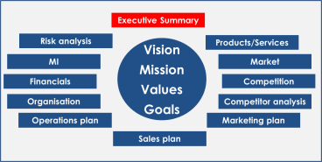
Executive Summary
This is the last section to be completed once all the others have been done.
Key points to understand from the rest of this document should be highlighted here:
What is the business selling
Who it is selling to
How will it compete with the competition
What are the key financial projections and sensitivities
What key metrics will be monitored to ensure that things are on track
Key risks and sensitivities

Slide 4
Contents
Side Number | Content
3 | Executive Summary
5 -6 | Vision, Mission, Values, and Goals
7 | Products and Services
8 | Market
9 | Competition
10 | Competitor analysis
11 - 16 | Marketing Plan
17 - 18 | Sales Plan
Side Number | Content
19 | Operations Plan
20 | Organisational Structure
21 | Financials: Profit and Loss
22 | Financials: Cash flow
23 | Management Information
24 | Risk analysis
25 | Appendices

Slide 5
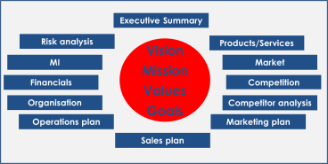
Vision, Mission, Values, and Goals (1)
Vision
What is my vision for this company? Where do we want to get to, how will we measure it and when will we get there?
Mission
The declaration of the general objectives and principles of operation
Who we are
What we do
Who our clients are
What makes us different
Values
What are the key values that shape the way the company does business? What will we do or not do in order to fulfil the mission?

Slide 6
Vision, Mission, Values, and Goals (2)
Business Goals
What does the business need to achieve and by when?

Slide 7
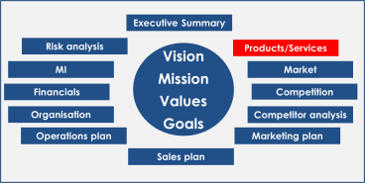
Product and/or Service
Product and/or Service
What product/service will this company be selling
What does it do (functionality)?
What does it do for the customer (ie why will they buy it – beware: this is not necessarily the same thing as it’s functionality!)?
How is it better than other similar products?
Are there any other offerings that are integral to the product (eg service contracts, consumables, ongoing relationship drivers etc)?
Other products that are complimentary or substitutes?
Pricing of the product

Slide 8
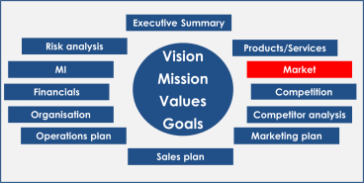
Market
Market for the product
Description of the market in order to define it (building on the definition of the product from previous section):
Geographic area
General types of customer and numbers of them (individuals, businesses etc)
Size of the market (numbers of units sold/number of transactions, value of units/transactions sold)
Historic growth rates
Projected growth rates
Number of competitors in the market
Concentration of competitors (ie how much of the market is accounted for by the top 3, top 5, and top 10).
Current trends in the market, why they are happening and what they mean for the future of the market
Any special regulation that is relevant to the market
Your current share of the market and hoped-for share of the market

Slide 9
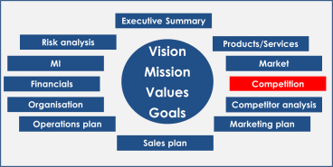
Competition
Competition
Who are they, how big are they, how much cash do they have, who owns them, what else do they sell, who do they sell to, how do they sell it?
Competitor name | Market share (%) | Turnover | Cash on hand | Who owns them | Products/ Services | Customers – who are they? | Sales approach

Slide 10
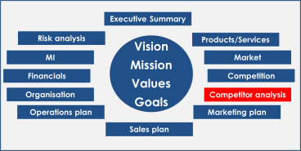
Competitor Analysis
Competitor Analysis
Building on who they are (previous section), how dangerous are they to us? Why would customers buy from us rather than them? What are our strengths and weaknesses relative to them? What do we need to do to beat them?
Competitor name | Danger rating (high, med, low) | Where are we stronger than them? | Where are we weaker than them? | Why do their customers buy from them? | What do we need to do to beat them?

Slide 11
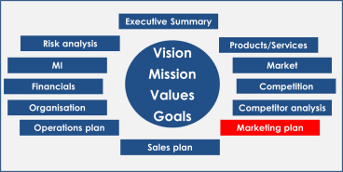
Marketing plan (1): Marketing Goals
Marketing Goals
This section sets the high-level scene for your marketing activity.
What is it that your business needs your marketing activity to deliver?
What are the main business issues that marketing should address (these should relate to your business goals)?

Slide 12
Marketing plan (2): Target Markets
Target Markets
Who will be buying the product/service? What defines and categorises them? Things to think about might include: age, wealth, location, the specific issues that they face that your product solves, other interests or activities they might perform, other products/services they might buy.
Question to think about: ‘if I had to describe my customers to someone from another planet who knew nothing about humans, what would I tell them to look for so that they could find more customers for me?’
There is almost certainly more than one target market – ie many segments…

Slide 13
Marketing Plan (3): Branding and Positioning
Brand/Position
Concept statement…
Customer Belief: A statement(s) that expresses the target customer’s needs: “You get me”
Statement of Benefit: A promise which answers the question: “What’s in it for me?”
Reasons to Believe: Supporting key information: “Why should I believe you?”
Elevator statement for the product:
For [target customer] who has [customer need], [product name] is a [market category] that [one key benefit]. Unlike [competition], the product [unique differentiator].
Brand personality
The character of the brand -what does it represent?
Image
Logos
Colour scheme
Font

Slide 14
Marketing Plan (4): Routes to market and objectives
Routes to target market
How will you reach each of your intended target markets? (eg face-to-face sales force? Inbound phone? Outbound phone? Own website? Other market place website? Etc)
– see sales plan later on for more detailed planning on this but the overview should be clear by this point.
Marketing Objectives
What does your marketing need to deliver?
Leads – numbers per period of time
Suspects – numbers per period of time
Prospects – numbers per period of time
Clients – numbers per period of time
Cost per client

Slide 15
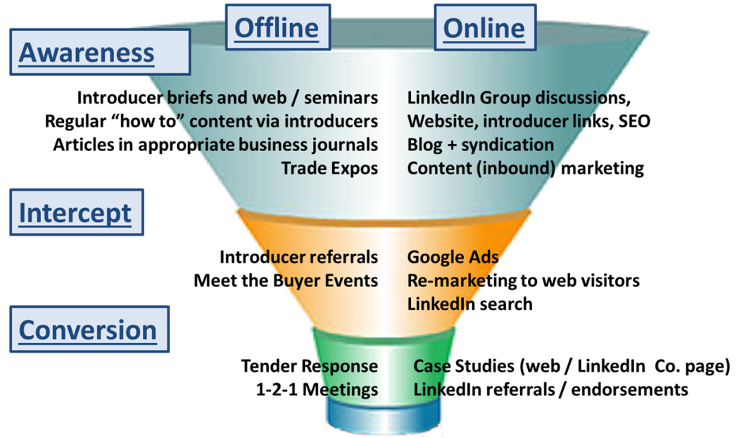
Marketing Plan (5): Marketing activity
Marketing Activity
Potential activities
Indirect – customer satisfaction surveys
Direct – calls, letters, brochures, emails
Advertising – print media, directories
Event marketing – trade shows seminars, demonstrations
Digital/online
Example:

Slide 16
Marketing Plan (6): Marketing activity plan
Marketing Activity
Start Date – end date | Activity | Activity type | Who is responsible | Budget | Targets/KPIs

Slide 17
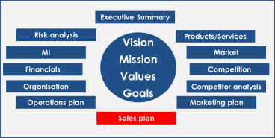
Sales Plan (1) : New Business Acquisition
New business acquisition plans
This section considers how you will manage the relationship with new customers in order to encourage them to purchase goods and services from your company. This section therefore builds directly on the marketing planning which provides the leads and prospects that your sales process should convert into clients.
What are the defined steps in the sales process for each channel? (ie what does the customer journey look like from initial contact through to completing an order)?
How is each step measured? (ie conversion rates/drop out rates between each step)
Who will measure it and how often?
What does ‘good’ look like for each step?

Slide 18
Sales Plan (1) : New Business Acquisition: Sales process steps and measurements
Step 1
………………….
Step 1
………………….
Step 1
………………….
Step 1
………………….
Step 1
………………….
Measurements
Targets
Measurements
Targets
Measurements
Targets
Measurements
Targets
Measurements
Targets
KPI measures/ratios for the sales funnel:
Key Ratios
Targets
Key Ratios
Targets
Key Ratios
Targets
Key Ratios
Targets

Slide 19
Sales Plan (1) : New Business Acquisition: Using the measurements to manage the sales process
 |  | Who
 |  | Sales Person | Team | Company
Frequency | Weekly | [who does what with each measurement to ensure that performance is improved] | [who does what with each measurement to ensure that performance is improved] | [who does what with each measurement to ensure that performance is improved]
 | Monthly | … | … | …
 | Quarterly | … | … | …

Slide 20
Sales Plan (2) : Customer retention
Customer retention plans
This section considers how you will manage the relationship with existing customers in order to encourage them to purchase more goods and services from your company (and/or renew existing services).
What does your existing customer base look like
Segmenting the existing customer base
What are the usual touch points throughout the relationship with the customer? (ie what does the customer journey look like after having made their initial purchase to buying something else or renewing your service)?
What will you do for each customer segment at each touchpoint to ensure you retain existing business and secure more sales?
How is each step measured? (ie conversion rates/drop out rates between each step)
Who will measure it and how often?
What does ‘good’ look like for each step?

Slide 21
Sales Plan (2) : Customer retention
What do you know about your existing customers?
Total number of customers
Longest standing customers
1.
2.
3.
4.
5.
6.
7.
8.
9.
10.
Largest customers by revenue
1.
2.
3.
4.
5.
6.
7.
8.
9.
10.
Most frequent customers
1.
2.
3.
4.
5.
6.
7.
8.
9.
10.
Most profitable customers
1.
2.
3.
4.
5.
6.
7.
8.
9.
10.
Which ones buy which products
…

Slide 22
Sales Plan (2) : Customer retention: Segmenting your
existing customers
 |  | Value to Customer
 |  | Low | High
Value to You | Low | One Offs Transaction only [which customers and why] | Drive value or lose Understand how to increase value [which customers and why]
 | High | At Risk Retention strategy required [which customers and why] | Focus Understand, Manage closely [which customers and why]

Slide 23
Sales Plan (2) : Customer retention; Touch points and strategies for each customer segment
Touch Point | One Offs | Drive Value or Lose | At Risk | Focus
1 [eg initial sale] | [What should be done by whom in order to maximise value] Measurements Targets | [What should be done by whom in order to maximise value] Measurements Targets | [What should be done by whom in order to maximise value] Measurements Targets | [What should be done by whom in order to maximise value] Measurements Targets
2 [eg technical support query] | [What should be done by whom in order to maximise value] Measurements Targets | [What should be done by whom in order to maximise value] Measurements Targets | [What should be done by whom in order to maximise value] Measurements Targets | [What should be done by whom in order to maximise value] Measurements Targets
3 …. | [What should be done by whom in order to maximise value] Measurements Targets | [What should be done by whom in order to maximise value] Measurements Targets | [What should be done by whom in order to maximise value] Measurements Targets | [What should be done by whom in order to maximise value] Measurements Targets

Slide 24
Sales Plan (2) : Customer retention; Using the measurements to manage the sales process
 |  | Who
 |  | Customer Service Person/ Account Manager | Team | Company
Frequency | Weekly | [who does what with each measurement to ensure that performance is improved] | [who does what with each measurement to ensure that performance is improved] | [who does what with each measurement to ensure that performance is improved]
 | Monthly | … | … | …
 | Quarterly | … | … | …

Slide 25
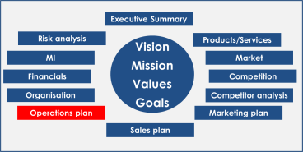
Operations Plan – (out of scope as it is company specific, but some things to think about which may be helpful…)
Defining the parameters that operations will need to work to
Products/services to be produced
Quantity of output per period of time to be achieved to meet demand
Variability in quantity of output per period of time to be coped with
Degree of standardisation expected/flexibility required
Capacity constraints
Expected utilisation rates
Quality requirements and approach
Order winners versus order qualifiers
Things that will win us the business compared to the competitors
Things that will lose use the business if we don’t have them (‘hygiene factors’)
Critical processes and equipment
Key processes
Key equipment and its replacement cycle
Inventory management
Stock levels and how they will be managed
Where the stock is (raw materials, work in progress, finished goods)
What sort of stock it is (demand anticipation, stock-out buffer, pipeline management etc)
Health and safety and Disaster Recovery
How will we ensure there is a safe system of work? How will we measure and monitor it?
How would we recover from a disaster that took down our operations?

Slide 26
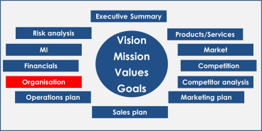
Governance and Organisation Structure
Key roles and responsibilities
Key roles and their responsibilities?
People filling their roles and their qualifications/ experience to do so?
Governance
What is the chain of command?
Board – role, members, secretariat, and meeting frequency?
Management team – role, members, secretariat, and meeting frequency?
Managing Director
Finance Director
Sales & Marketing Director
Operations Director

Slide 27
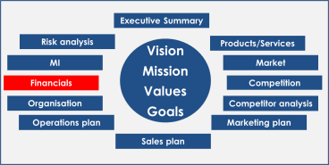
Financials (1): Profit and Loss
See separate spreadsheet template for producing this
High level results can be summarised here for presentational and completeness
 | Next year | % change this year -> next year | This year | % change last year -> this year | Last year (for comparison)
Sales
Direct cost of goods sold
Gross Profit
Gross profit margin
Overheads
Net profit
Net profit margin
Break-even sales volume
What is the minimum amount we need to sell in order to break even?

Slide 28
Financials (2): Cash flow
See separate spreadsheet template for producing this
High level results can be summarised here for presentation
Note that this needs to be modelled monthly rather than annually for management purposes so this is just a summary
 | Next year | % change this year -> next year | This year | % change last year -> this year | Last year (for comparison)
Cash balance at start of period
Cash in from sales
Cash out to expenses
Cash out to overheads
Cash balance at end of period
Cash available from financing
Cash balance available

Slide 29
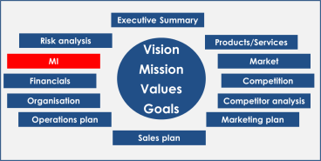
Management Information and KPIs
What do we need to measure?
What measures do we need to monitor in order to know whether we’re on track’ (Key Performance Indicators (KPIs))?
Financial ones?
Marketing ones?
Sales process ones?
Operations ones?
How are they defined?
What does ‘on track’ look like for each measure?
How often do we collect the information?
Who is in charge of collecting it?
Who is in charge of reviewing it?
How often will they review it?
KPI Name | Definition | ‘On track’ level | Who produces | Who reviews | Frequency of review?

Slide 30
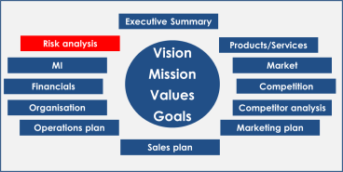
Risk and Sensitives
What would stop us achieving the plan?
What are the biggest risks to the plan?
Likelihood of them happening (score 1 -5)
Impact if they do happen (score 1 – 5)
Multiply the scores together to give a risk rating
What will we do to manage the risks (specific ‘controls’ and ‘treatments’)?
What would break my business?
Scenarios that could cause this?
What would our response be in these situations?
Can we do anything sensible now just in case?
Risk | Description | Probability (1 low, 5 high) | Impact (1 low, 5 high) | Risk Score (prob x impact) | Controls and treatment?

Slide 31
Appendices

